Slide 1
5COSC019W – Object Oriented Programming Week 12
Dr. Barbara Villarini
b.villarini@westminster.ac.uk

Slide 2
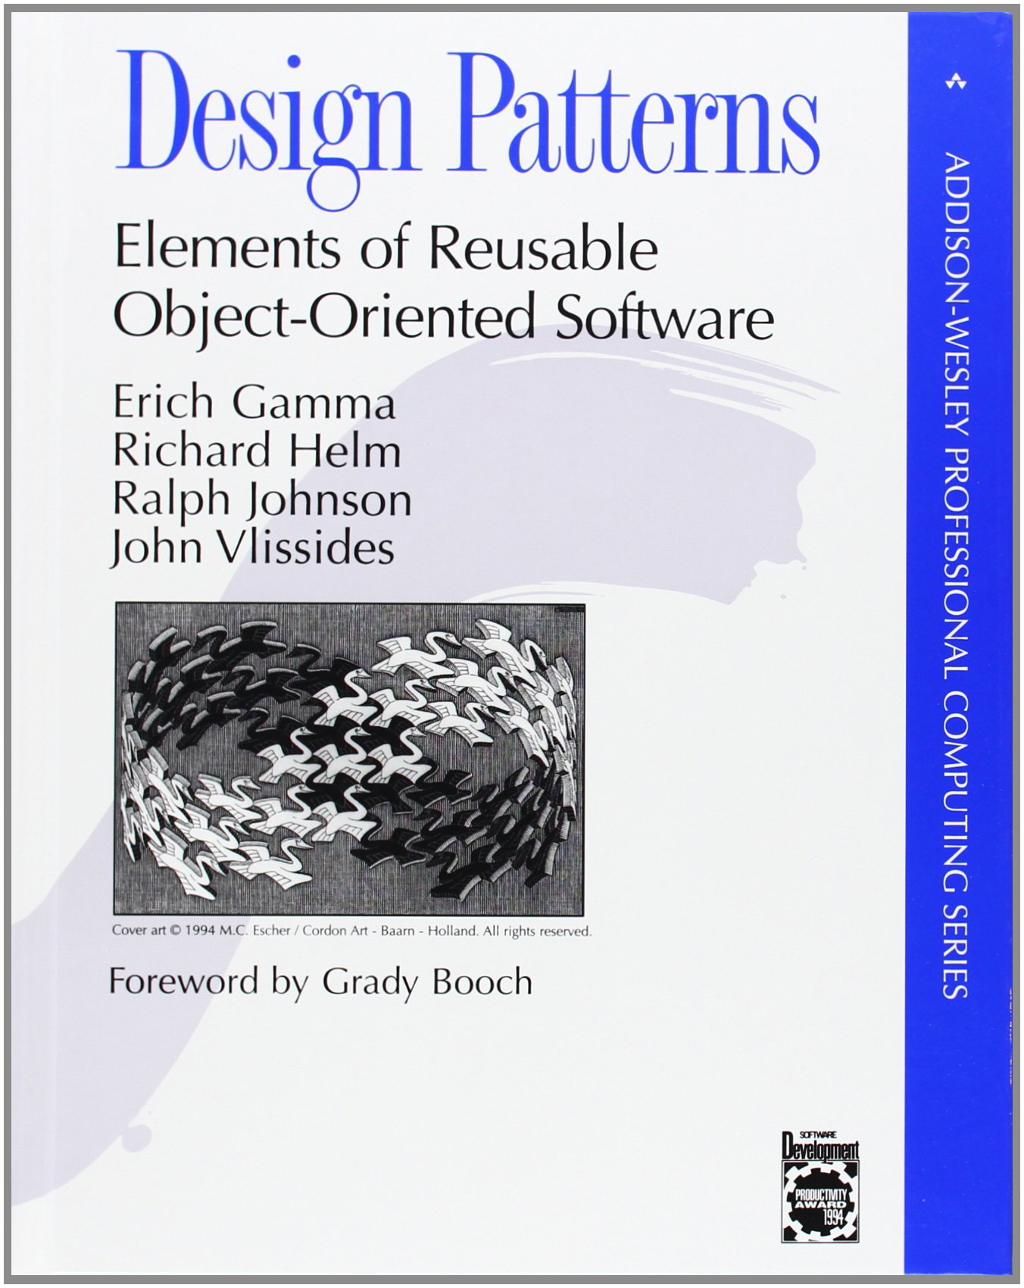
Summary
Introduction: Why a design pattern?
What is a design pattern
How we describe a design pattern
Classification of Design Pattern
Examples:
Composite
Singleton
Observer
Factory

Slide 3
Why a design pattern
Reusability: one of Wasserman’s rules(1996) for an efficient and actual software development
It helps new designer to have a more flexible and reusable design
Improves the documentation and maintenance of existing system by furnishing an explicit specification of class end object interactions and their intent
Notes:
It is a general, reusable solution to a commonly occurring problem within a given context in software design. It is not a finished design that can be transformed directly into source or machine code. It is a description or template for how to solve a problem that can be used in many different situations. Design patterns are formalized best practices that the programmer can use to solve common problems when designing an application or system.

Slide 4
What is Design Pattern
Christopher Alexander says “ Each pattern describes a problem which occurs over and over again in our environment, and then describes the core of the solution to that problem, in such a way that you can use this solution a million times over, without ever doing it the same way twice”
A design pattern is a descriptions of communicating objects and classes that are customized to solve a general design problem in a particular context
A pattern is made by four elements:
Name
Problem
Solution
Consequences

Slide 5
Design Patter - Name
Describe a design problems and its solutions in a word or two
Used to talk about design pattern with our colleagues
Used in the documentation
Increase our design vocabulary
Have to be coherent and evocative
Notes:
Having a vocabulary for patterns lets us talk about them – developing a catalog of patterns
Higher level of abstraction
Hard part finding good names

Slide 6
Design Pattern - Problem
Describes when to apply the patterns
Explains the problem and its context
Sometimes include a list of conditions that must be met before it makes sense to apply the pattern
Have to occurs over and over again in our environment
Notes:
Problem and its context: how to represent algorithms as objects

Slide 7
Design Pattern - Solution
Describes the elements that make up the design, their relationships, responsibilities and collaborations
Does not describe a concrete design or implementation
Has to be well proven in some projects
Notes:
Does not describe a concrete implementation because a patter is like a template that can be applied in many different situation.
It provides an abstract description

Slide 8
Design Pattern - Consequences
Results and trade-offs of applying the pattern
Helpful for describe design decisions, for evaluating design alternatives
Benefits of applying a pattern
Impacts on a system’s flexibility, extensibility or portability
Notes:
To understand the cost and benefits

Slide 9
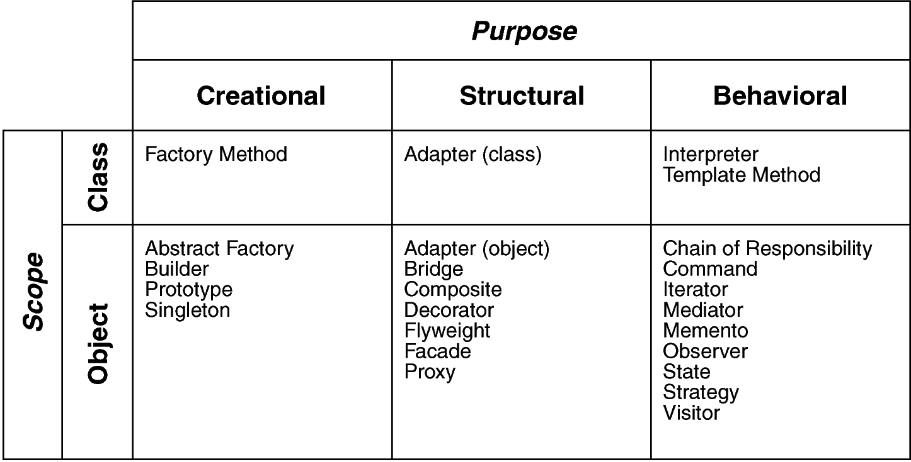
Classification of Design Pattern
Scope: domain over which a pattern applies
Purpose: reflects what a pattern does
Notes:
Scope: specifies whether the pattern applies primary to classes or object. Class patterns deal with relationship between classes and their subclasses. (Relationship such as inheritance that is the most used…almost every pattern use it) Satic, fixed at run time.
Object patterns deal with object relationships that can change at run time that are dynamic.
Creational: concern object creation, Structural deal with composition of classes and objects, behavioral is how class and objects interacts

Slide 10
Creational Patterns
Abstract the instantiation process
Make a system independent to its realization
Class Creational use inheritance to vary the instantiated classes
Object Creational delegate instantiation to an another object
Notes:
Creational class defers Some part of object creation to subclasses, while creational objects defers to another object

Slide 11
Structural Patterns
Class Structural patterns concern the aggregation of classes to form largest structures
Object Structural pattern concern the aggregation of objects to form largest structures
Notes:
Way to assamble object

Slide 12
Behavioural Patterns
Concern with algorithms and assignment of responsibilities between objects
Describe the patterns of communication between classes or objects
Behavioral class pattern use inheritance to distribute behavior between classes
Behavioral object pattern use object composition to distribute behavior between classes

Slide 13
Some patterns

Slide 14
Singleton
Some classes have conceptually one instance
Many printers, but only one print spooler
One file system
One window manager
Ensure a class only has one instance
Provide a global point of access to it
Notes:
A software program responsible for managing all print jobs currently being sent to the computer printer or print server.
A global variable makes an object accessible but does not prevent instantiating multiple objects
The class is responsible of its own instance and that no other instance can be created

Slide 15
Singleton Motivation
Class is responsible for tracking its sole instance
Make constructor private
Provide static method/field to allow access to the only instance of the class
Benefit:
Reuse implies better performance
Class encapsulates code to ensure reuse of the object; no need to burden client

Slide 16
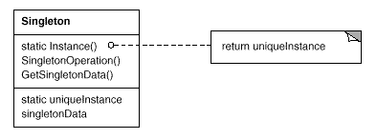
Singleton Pattern

Slide 17
Implementing the Singleton method - Java
In java:
public class Singleton {
private Singleton() {…}
final private static Singleton instance = new Singleton();
public static Singleton getInstance() {
return instance; }
protected void demoMethod( ) {
System.out.println("demoMethod for singleton");
}
}
Constructor
Class Variable
Method to return the instance
Other methods

Slide 18
Singleton Demo
public class SingletonDemo {
public static void main(String[] args) {
Singleton tmp = Singleton.getInstance( );
tmp.demoMethod( );
}
}
This will produce the following Output:
demoMethod for singleton

Slide 19
Factory Pattern
It is a creational pattern that can be used to create objects without specifying the exact classes of the object that will be created
It is the most used design pattern
It creates objects by calling a factory method, either in an interface and implemented by child class, or implemented in a base class and optionally overridden by derived classes.
Objectives:
Create an object in such a manner that subclasses can redefine which class to instantiate.
Defer instantiation to sub classes.

Slide 20
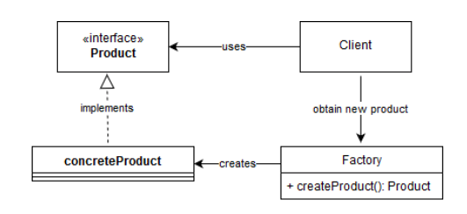
Factory Pattern
Factory – Implements method to create concrete product objects.
Product – Interface for a product
ConcreteProduct – Implements the Product interface and defines a concrete Product object which is created by the Factory.
Client – Uses Factory to create product which is accessed by the interface.
Benefits:
Isolation of concrete classes
Consistency among products
Notes:
Isolation of concrete classes – You have more control over the classes of objects that an application creates. As a factory encapsulates the responsibility and the process of creating product objects, it isolates clients from implementation classes.
Consistency among products – In scenarios, when product objects in a family are designed to work together, it’s important that an application use objects created by the factory.

Slide 21
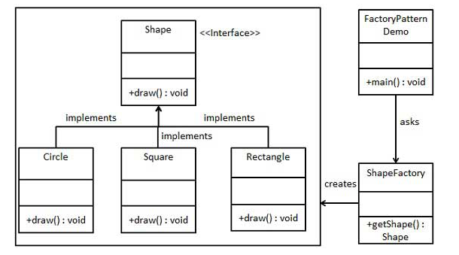
Example
We're going to create a Shape interface and concrete classes implementing the Shape interface. A factory class ShapeFactory is defined as a next step.
FactoryPatternDemo, our demo class will use ShapeFactory to get a Shape object. It will pass information (CIRCLE / RECTANGLE / SQUARE) to ShapeFactory to get the type of object it needs.
+getShape
(String:s):
Shape

Slide 22
Step 1
Create an interface (Shape.java).
public interface Shape {
void draw();
}

Slide 23
Step 2
Create concrete classes implementing the same interface.
public class Rectangle implements Shape {
@Override
public void draw() {
System.out.println("Inside Rectangle::draw() method.");
}}
public class Square implements Shape {
@Override
public void draw() {
System.out.println("Inside Square::draw() method.");
}}
public class Circle implements Shape {
@Override
public void draw() {
System.out.println("Inside Circle::draw() method.");
}}

Slide 24
Step 3
Create a Factory to generate object of concrete class based on given information.
public class ShapeFactory {
//use getShape method to get object of type shape
public Shape getShape(String shapeType){
if(shapeType == null){
return null;
}
if(shapeType.equalsIgnoreCase("CIRCLE")){
return new Circle();
} else if(shapeType.equalsIgnoreCase("RECTANGLE")){
return new Rectangle();
} else if(shapeType.equalsIgnoreCase("SQUARE")){
return new Square();
}
return null;}}

Slide 25
Step 4
Use the Factory to get object of concrete class by passing an information such as type.
public class FactoryPatternDemo {
public static void main(String[] args) {
ShapeFactory shapeFactory = new ShapeFactory();
//get an object of Circle and call its draw method.
Shape shape1 = shapeFactory.getShape("CIRCLE");
//call draw method of Circle
shape1.draw();
//get an object of Rectangle and call its draw method.
Shape shape2 = shapeFactory.getShape("RECTANGLE");
//call draw method of Rectangle
shape2.draw();
//get an object of Square and call its draw method.
Shape shape3 = shapeFactory.getShape("SQUARE");
//call draw method of square
shape3.draw();}}

Slide 26
Composite Pattern
Let’s clients treat individual objects and compositions of objects uniformly
Compose objects into tree structures to represent part-whole hierarchies
Motivation:
support recursive composition in such a way that a client need to not know the difference between a single and a composite object
Applicability:
when dealing with hierarchically-organized objects (e.g., columns containing rows containing words …)
Notes:
Especially in graphics like drawing editors using complex diagrams. The user can group components to form large component, which they can group to form bigger components

Slide 27
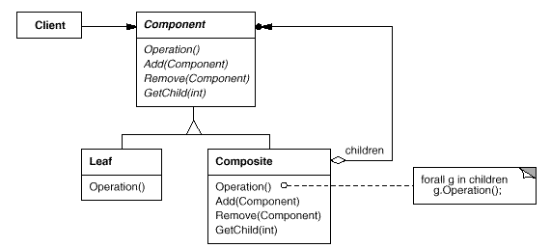
Example Composite
Notes:
Component: interface, default behaviour
Leaf objects: they don’t have children, define behaviour for primitive object
Composite: behaviour for components that have children, store child component, child related operation
Client: manipultes object in the composition through the interface

Slide 28
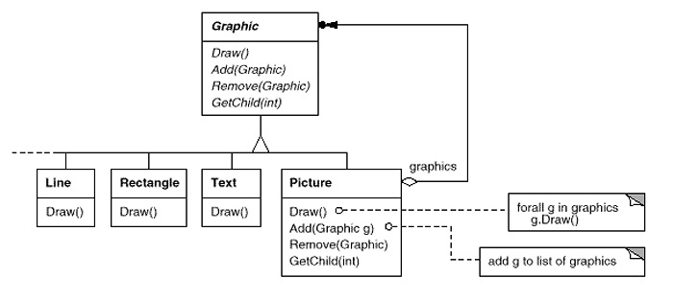
Composite - example

Slide 29
Consequences Composite
Consequences:
class hierarchy has both simple and composite objects
simplifies clients
aids extensibility
clients do not have to be modified
too general pattern?
difficult to restrict the components of a composite
Notes:
Sometimes you want to have only certain components

Slide 30

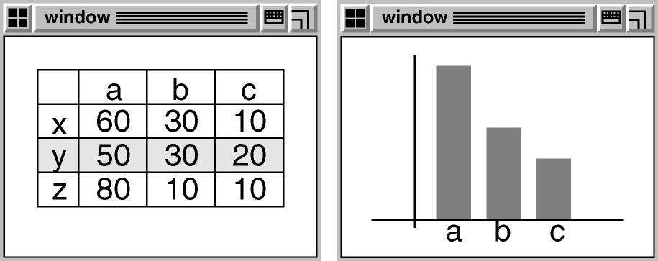
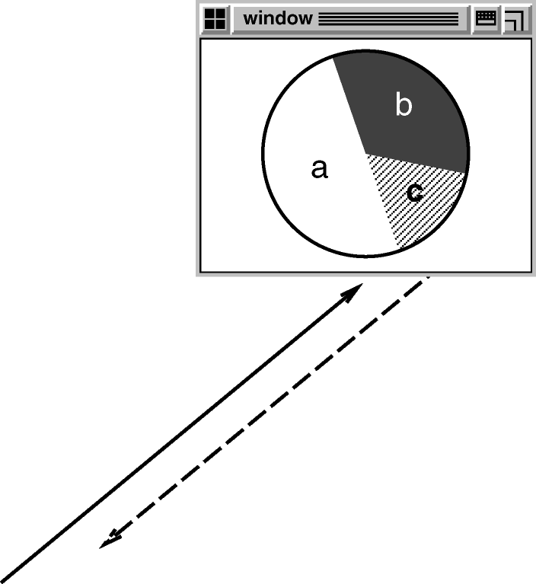
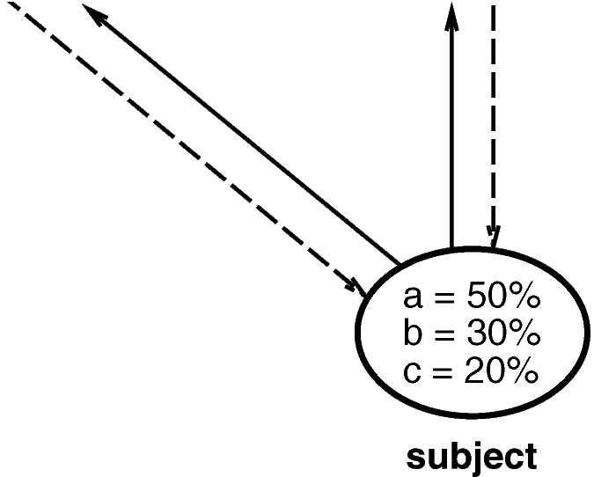

Observer Pattern
Define a one-to-many dependency between objects so that when one object changes state, all its dependents are notified and updated automatically
Motivation:
Notes:
Needs to maintain consistency between related objects but at the same time you don’t want to implement class too similar otherwise you lose in reusability.

Slide 31
Observer Pattern
Problem
dependent’s state must be consistent with master’s state
Solution structure
define four kinds of objects:
Subject
maintain list of dependents; notifies them when master changes
Observer
define protocol for updating dependents
Concrete subject
Store state of interest to Concrete Observer object; send notification to its observer when its state change
Concrete observers
Maintain a reference to Concrete Subject object
get new subject state upon receiving update message
Implements the Observer updating interface to keep its state consistent with the subject’s

Slide 32
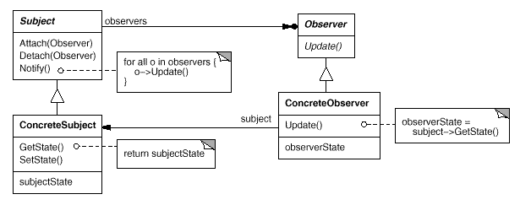
Observer structure
Notes:
Subject
maintain list of dependents; notifies them when master changes
Observer
define protocol for updating dependents
Concrete subject
Store state of interest to Concrete Observer object; send notification to its observer when its state change
Concrete observers
Maintain a reference to Concrete Subject object
get new subject state upon receiving update message
Implements the Observer updating interface to keep its state consistent with the subject’s

Slide 33
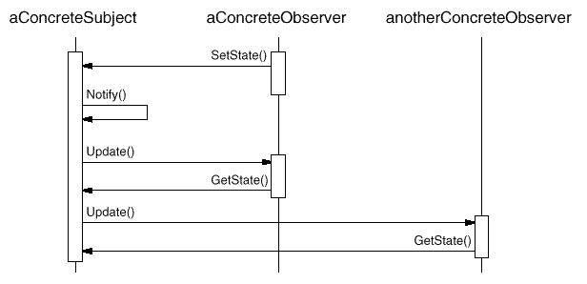
Use of Observer

Slide 34
Observer Consequences
Low coupling between subject and observers
subject unaware of dependents
Support for broadcasting
dynamic addition and removal of observers
Unexpected updates
no control by the subject on computations by observers
Notes:
1) Abstract coupling between Subject and Observer. All a subject knows is that it has a list of observers, each conforming to the simple interface of the abstract Observer class. The subject doesn't know the concrete class of any observer. Thus the coupling between subjects and observers is abstract and minimal.
2) The subject doesn't care how many interested objects exist; its only responsibility is to notify its observers. This gives you the freedom to add and remove observers at any time. It's up to the observer to handle or ignore a notification.
3) Because observers have no knowledge of each other's presence, they can be blind to the ultimate cost of changing the subject.

Slide 35
Example
The standard Java event model is an example of an observer pattern
Notes:
The observer pattern is very common in Java. For example, you can define a listener for a button in a user interface. If the button is selected, the listener is notified and performs a certain action.
But the observer pattern is not limited to single user interface components. For example, you could have a part A in your application which displays the current temperature.
Another part B displays a green light if the temperature is above 20 degree celsius. To react to changes in the temperature, part B registers itself as a listener to Part A.
If the temperature in part A is changed, an event is triggered. This event is sent to all registered listeners, as, for example, part B. Part B receives the changed data and can adjust its display.

Slide 36
Something more…

Slide 37
Prepare to reply to the following questions:
Why do you want to work for this company?
Show that you know very well what the company does
Show interest about their work
Show that you’re passionate about technology
What do you like about the company work? What would you improve (in terms of their products)?
Offering specific recommendations can show your passion for the job.
How much of your day do you spend coding?
Can you tell me about a challenging interaction with a teammate?

Slide 38
Your Resume
Resume screeners look for the same things that interviewers do:
Are you smart?
Can you code?
Relevant Jobs: Your resume does not - and should not - include a full history of every role you’ve ever had. Include only the relevant things
Writing Strong Bullets: For each role, try to discuss your accomplishments with the following approach: “Accomplished X by implementing Y which led to Z”
Here’s an example: “Reduced object rendering time by 75% by applying Floyd’s algorithm, leading to a 10% reduction in system boot time ”

Slide 39
Projects
Almost every candidate has some projects, even if they’re just academic projects
List them on your resume! I recommend putting a section called “Projects” on your resume and list your 2 - 4 most significant projects
State:
what the project was
which languages or technologies it employed
whether it was an individual or a team project
If your project was not for a course, that’s even better! It shows passion, initiative, and work ethic.

Slide 40
Programming languages and software
Software: It is not good to write that you’re familiar with Microsoft Office. Familiarity with developer-specific or highly technical software (e g , Visual Studio, Eclipse, Linux) can be useful.
Languages: Do you list everything you’ve ever worked with? Or only the ones that you’re more comfortable with (even though that might only be one or two languages)? I recommend the following compromise: list most languages you’ve used, but add your experience level. This approach is shown below:
“Languages: Java (expert), C++ (proficient), JavaScript (prior experience), C (prior experience)”

Slide 41
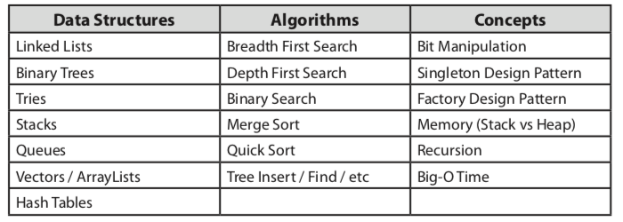
Technical questions
Get prepared on the following topics:

Slide 42
How you can be prepared for an interview…
Link
https://www.hackerrank.com
http://www.indiabix.com/engineering/
Book
Cracking the Coding Interview: 150 Programming Questions and Solutions

